Slide 1
Legal Advice and Documentation Knowledge Base Chatbot
Team Members:
Sai Charan Guntupalli - Team Leader
Akhil Ajithkumar

Slide 2
Problem Statement
Running GenAI on Intel AI Laptops and Simple LLM Inference on CPU and fine-tuning of LLM Models using Intel® OpenVINO™
Accessing legal information can be complex and time-consuming.
Legal professionals and individuals often need quick and accurate answers to legal queries.
Running GenAI models on Intel AI laptops for legal knowledge inference can optimize resource usage and efficiency.
There is a need to fine-tune LLM models using Intel® OpenVINO™ for efficient CPU inference and quantization techniques to manage large models.

Slide 3

Unique Idea Brief (Solution)
Our chatbot leverages GenAI models running on Intel AI laptops to provide accurate legal advice and documentation support.
It uses a specialized knowledge base built from legal PDFs, enabling quick retrieval of legal information.
The chatbot performs CPU inference using ONNX Runtime and a frontend built with Gradio, providing real-time responses to user queries.
Quantized the model to 8 Bit for a quicker inference.

Slide 4
Features Offered
Legal Knowledge Base: The chatbot leverages a comprehensive repository of legal documents, including statutes, case laws, legal textbooks, and procedural guides. Users can easily upload their own PDFs, ensuring the chatbot has access to the most relevant and up-to-date legal information. A lawyer can upload recent case laws to update the chatbot's knowledge base, allowing it to provide the latest legal precedents in responses.
Natural Language Understanding: Utilizing advanced NLP (Natural Language Processing) techniques, the chatbot understands and processes user queries in natural language. This means users can interact with the chatbot using everyday language without needing to learn complex legal jargon or query formats, making the system accessible to individuals without a legal background. A user asking "What are my tenant rights in a rental dispute?" will receive a comprehensible answer sourced from relevant legal texts.
Real-Time Response: The chatbot provides instantaneous responses by performing efficient CPU inference using the ONNX Runtime. Immediate access to legal information is crucial in urgent situations, such as during a court case or when making legal decisions on short notice. During a court session, a lawyer can quickly verify procedural requirements or legal precedents by querying the chatbot.
Contextual Awareness: The chatbot delivers context-aware responses by understanding the specific legal scenario of the user’s query. This ensures the advice given is not only accurate but also relevant to the user's specific situation, providing nuanced and applicable legal guidance. If a user inquires about filing for bankruptcy, the chatbot can distinguish between personal and business bankruptcy laws, offering tailored advice accordingly.

Slide 5
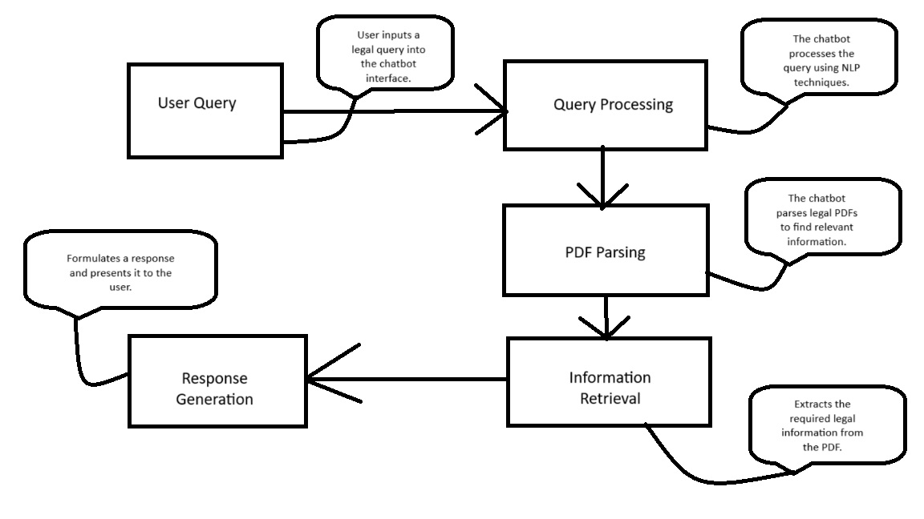
Process flow

Slide 6
Architecture Diagram User Interface: Gradio-based frontend for user interaction. Query Processor: Component that processes and understands user queries. PDF Parser: Extracts and indexes content from legal PDFs. Vector database: vector database efficiently retrieves relevant documents based on query embeddings, enhancing the LLM's context and accuracy. It supports large datasets and dynamic updates, ensuring the model provides current and relevant information. Inference Engine: Executes inferencing tasks on CPU using ONNX Runtime. Response Generator: Generates and formats the response to be displayed to the user.

Slide 7
Technologies used
Programming Language: Python
Frontend: Gradio
Inferencing: ONNX Runtime for CPU inference
Model Optimization: Intel® OpenVINO™ for model optimization and quantization
Fine-Tuning Techniques: LoRA, QLoRA for efficient fine-tuning of LLM models

Slide 8
Team members and contribution:
Sai Charan Guntupalli – Implementation of the whole flow , and research on vector database and converting models to openvino format.
Akhil Ajithkumar - Research and fine tuning based on quantization techniques and model optimization.

Slide 9
Conclusion
Our legal advice and documentation chatbot project showcases the potential of GenAI on Intel AI laptops.
It efficiently provides accurate and context-aware legal information through CPU inference and model fine-tuning.
The use of Intel® OpenVINO™ for model optimization and techniques like quantization ensures effective deployment and performance.
This solution can significantly enhance access to legal knowledge and support, benefiting legal professionals and the general public in real time and upto date information.

